Slide 1
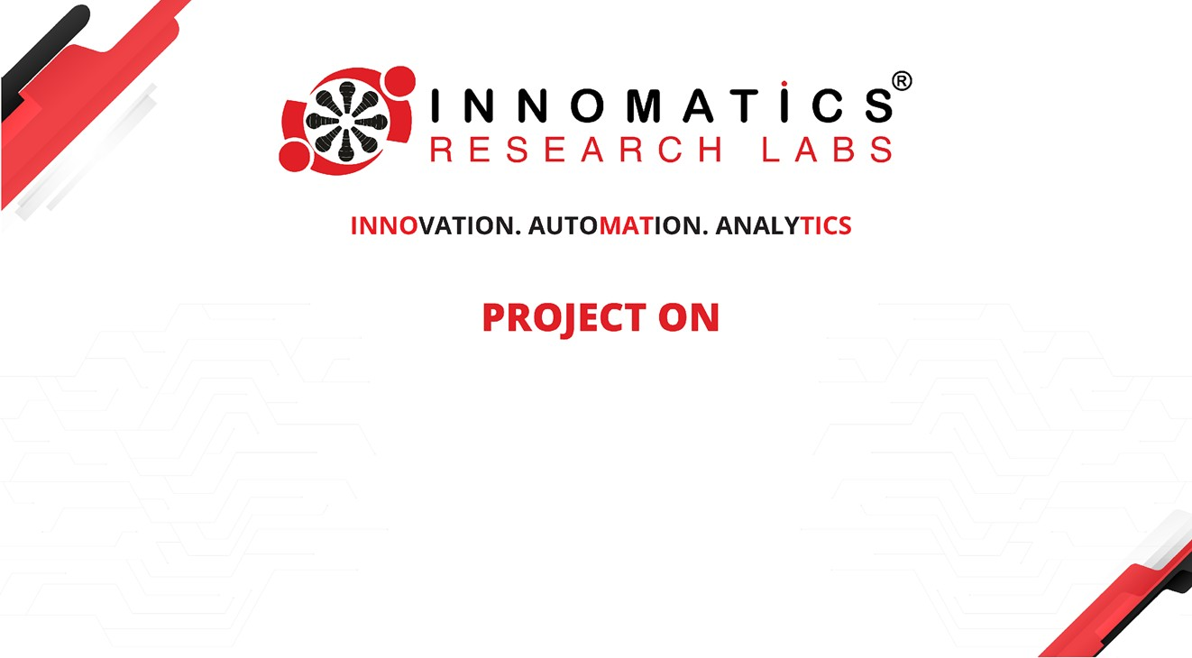
CODE REFACTORING AND BUG FIXING

Slide 2
About me
Background
My name is Santhosh, and I graduated with a Bachelor's degree in Electronics and Communication Engineering (ECE) from JB Institute of Engineering and Technology in 2023. During my undergraduate studies, I developed a keen interest in leveraging technology to solve complex problems. This interest led me to explore various domains within the field of technology, ultimately sparking my curiosity in data science.
Why I want to learn Data Science
After completing my Bachelor's degree, I recognized the growing significance of data science in driving innovation and informed decision-making across industries. I decided to pursue a data science course at Innomatics Research Labs. I was particularly drawn to the prospect of acquiring skills in statistical analysis, machine learning, and data visualization, which are crucial for addressing contemporary challenges and unlocking new opportunities in today's data-driven world.
Work experience
Currently, I am gaining practical experience in data science through an internship at Innomatics Research Labs. In this role, I am actively involved in diverse projects that encompass data collection, preprocessing, analysis, and model development. Through hands-on experience, I am honing my skills in Python programming, data manipulation, and the implementation of machine learning algorithms .
github
LinkedIn

Slide 3
Objective of the project
Refactor the existing codebase and ensure the proper functioning of the note taking application .Document all identified bugs during the debugging process .
Technical Tools Used
Python
Flask
HTML
CSS

Slide 4
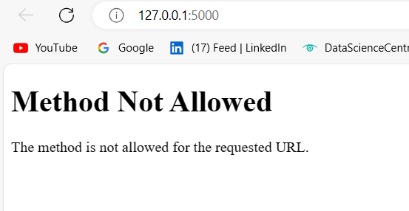
Task to do
Fix the bugs from front end html to backend python and Flask
Bugs
Bug 1

Slide 5
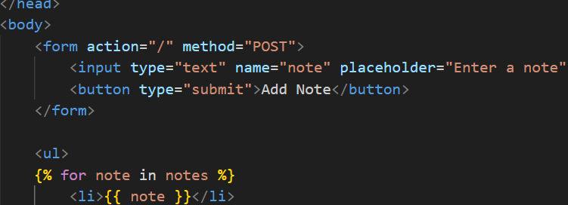
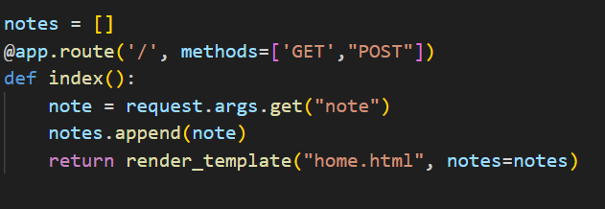
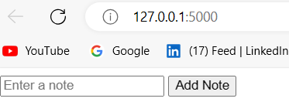
Solved
By adding post method to html form and action ‘/’ and GET in app.py

Slide 6
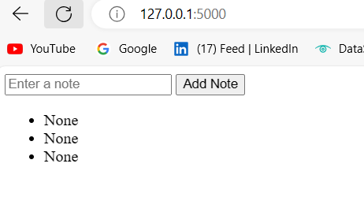
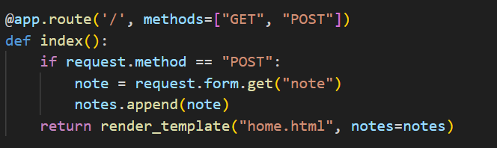
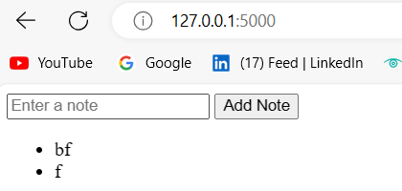
Bug 2
Not able to add note
Solved

Slide 7
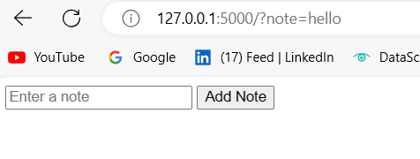
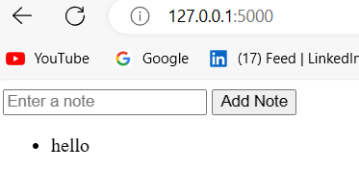
Bug 3
Getting parameters in the url
Solved
Getting parameters in the url

Slide 8

THANK YOU

